Slide 1
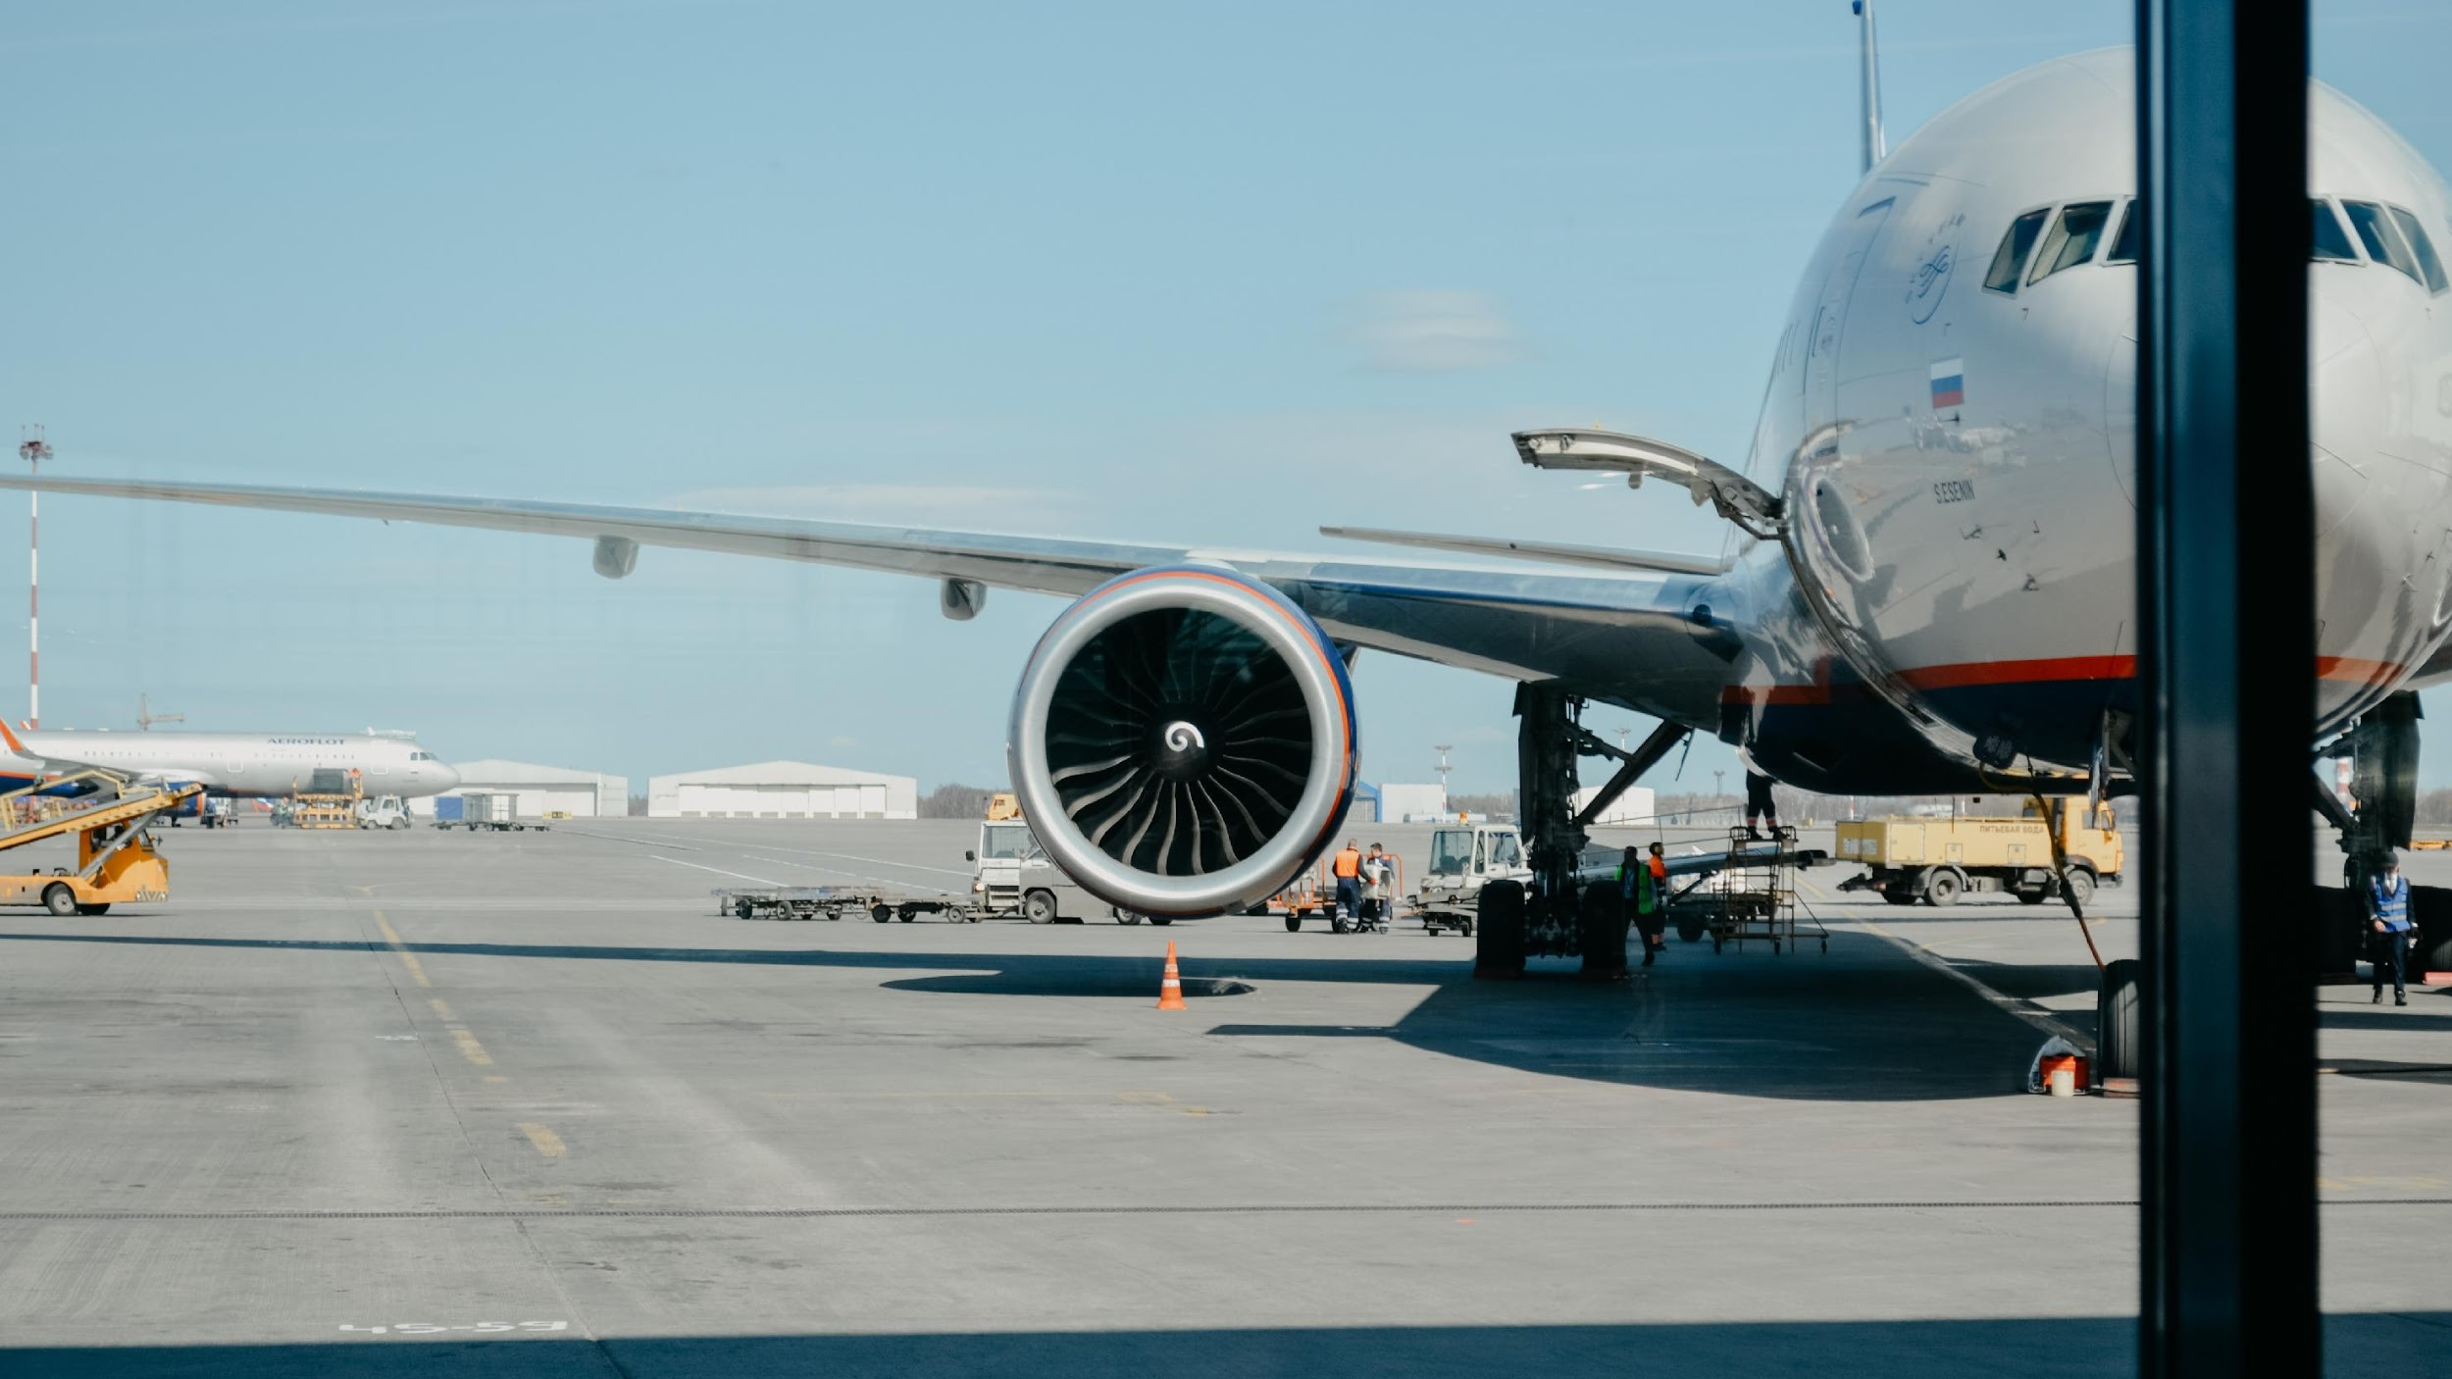
Flight Delay Analysis
Team 2: Emeline Ruvinskiy, Stephen Thomas, Joyce Zhang
Notes:
Creadit picture : Unsplash Iwan Shimko @iwnph
Link : https://unsplash.com/photos/tCp2K2sYpFg

Slide 2

DATA MOTIVATION
IMPLICATIONS OF COVID-19 ON THE AIRLINE INDUSTRY
INCREASING COSTS FOR FLIGHT DELAYS
U.S airlines passenger volumes were 63% below year-ago levels
The cost of delays has increased about $10 billion from 2016 to 2019
Costs an airline $74 for every minute a flight is delayed

Slide 3
DATA DESCRIPTION
322 records
14 records
Important Variables: airport name, airline name, destination airport, origin airport, departure delay, arrival delay, taxi-in, taxi-out, among other
taxi-in: time the aircraft spends between landing and reaching the gate
taxi-out: time the aircraft spends between leaving the gate and take-off
5.8 million records
Airports
Flights
Airlines

Slide 4
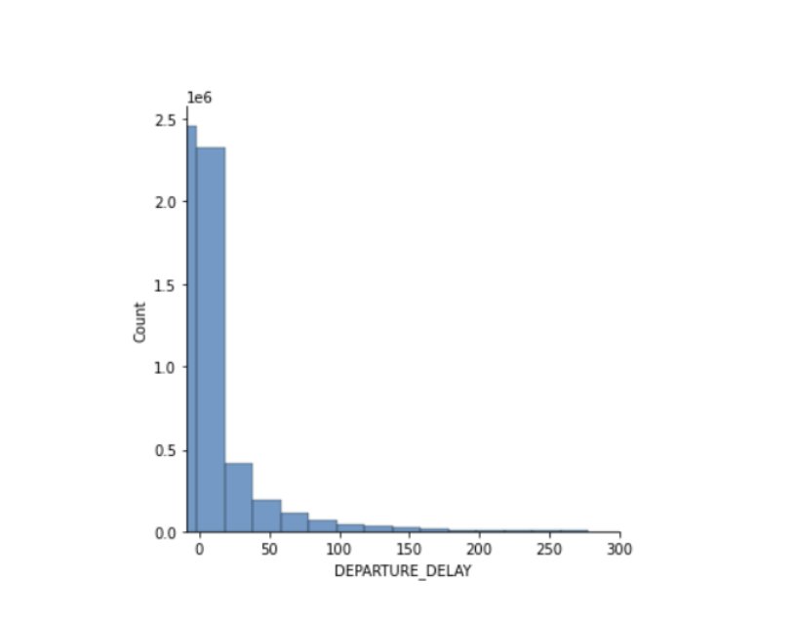
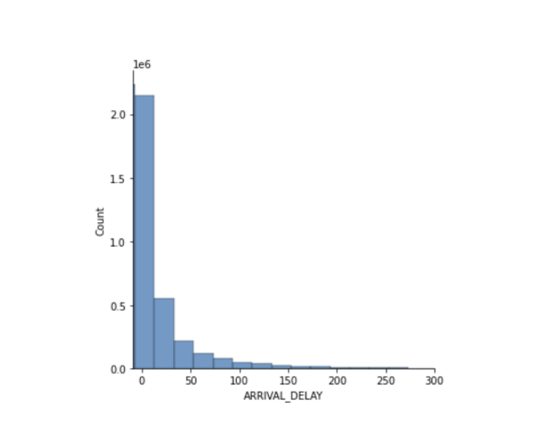
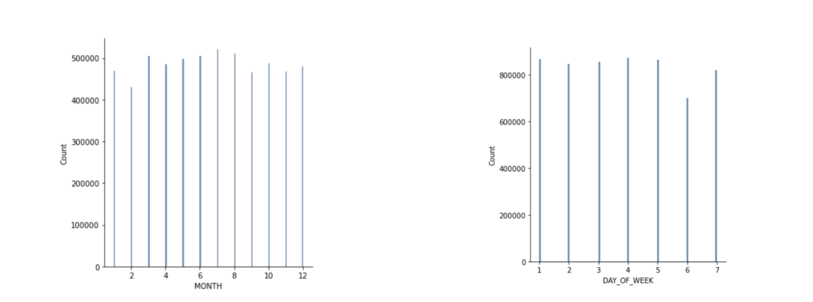
EXPLORATORY VISUALIZATIONS
Most arrival and departure delays were less than an hour long
The summer months had the most flights
School breaks and summer vacations
Saturdays had the least amount of flights
plane tickets more expensive for weekend flights

Slide 5

AIRLINE INSIGHTS AND ANALYTICS
SOUTHWEST
SPIRIT AIRLINES
UNITED AIRLINES
DELTA AIRLINES
Known for quick turnarounds and high utilization
# 1 number of flights in 2015
Late aircraft dominant reason for flight delays
Ultra low-cost carrier
#1 average departure and arrival delays
#1 average taxi-in time
Air system is the biggest delay reason
#1 in recovering departure delay
#2 average departure delay
Airline is the biggest delay reason
#2 in recovering departure delay
#11 average departure delay
Weather is the biggest delay reason

Slide 6
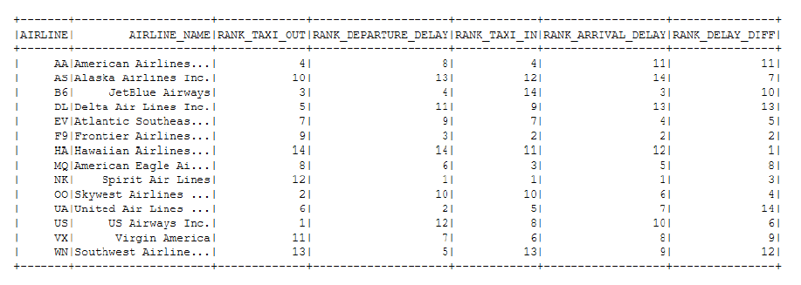
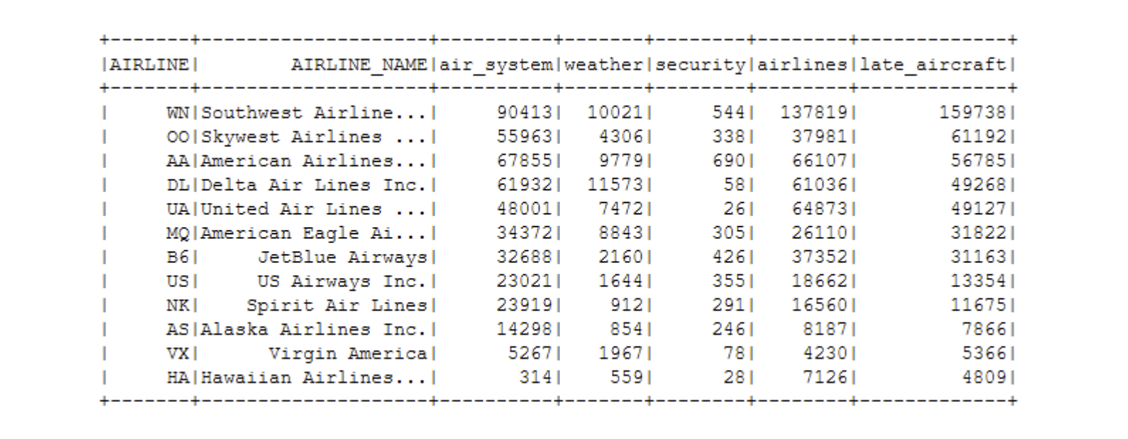
AIRLINE INSIGHTS AND ANALYTICS
High correlation between departure delays and arrival delays
High correlation of 94%, high rank in departure delay, high rank in arrival delay
Major airlines have advantages in recovering time loss from departure
If major airlines had departure delay, a higher chance that they will catch up these delays through flying and landing
Out of all the delay reasons, security-related delays were the least prominent

Slide 7
AIRPORT INSIGHTS AND ANALYTICS
WILMINGTON AIRPORT
ST CLOUD REGIONAL AIRPORT
HARTSFIELD JACKSON INTERNATIONAL AIRPORT
located in Delaware
#1 average departure delay among all the other origin airports
Average departure delay time is 29.39 minutes
Located in Minnesota
#1 average arrival delay
Average arrival delay time 23.03 minutes
Most popular original and destination airport
#121 in departure delay
#209 in arrival delay

Slide 8
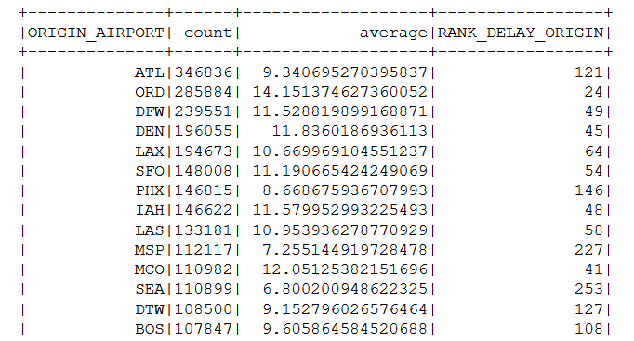
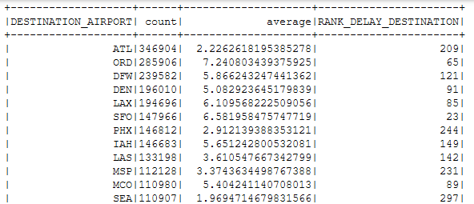
AIRPORT INSIGHTS AND ANALYTICS
Airports with the highest delay are surprisingly small airports
Airports with the highest delay are the ones do not have high frequency of flights
Larger airports have better system of managing traffic and direct the flows of flights

Slide 9
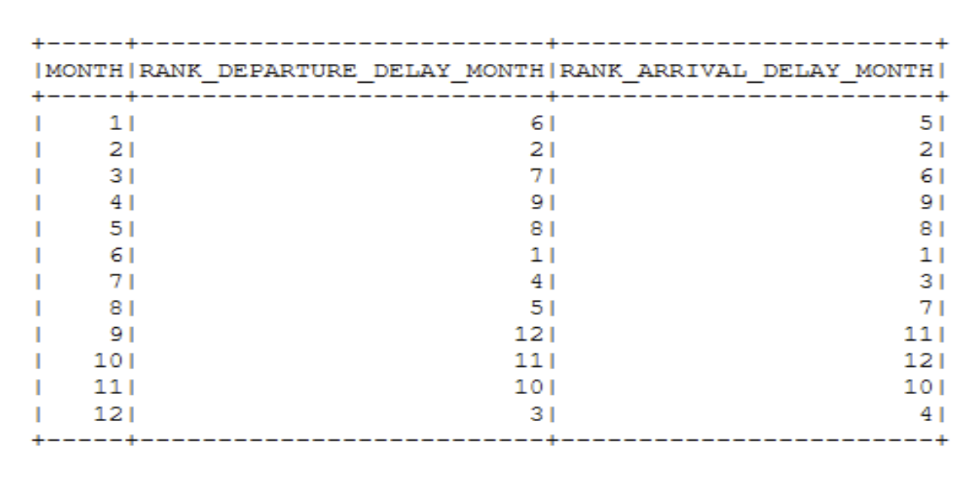
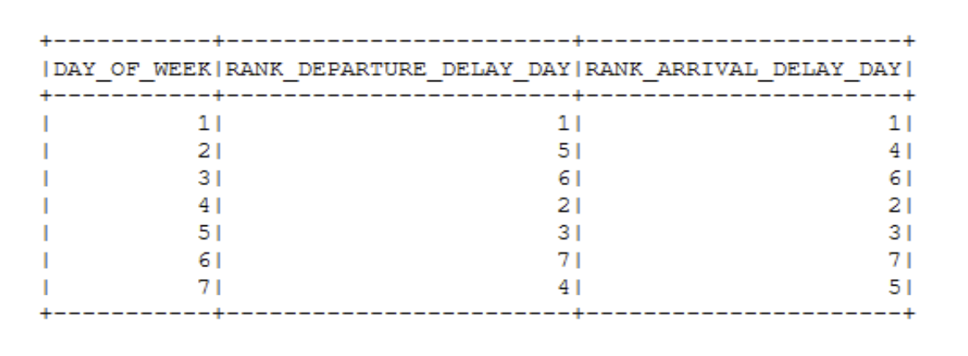
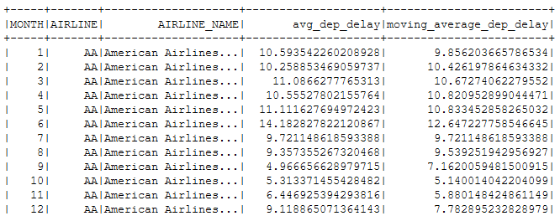
TIMING INSIGHTS AND ANALYTICS
Highest departure and arrival delays
Month - June
Day of the week - Monday
Lowest arrival delays
Month - October
Day of the week - Saturday
Lowest departure delays
Month - September
Day of the week - Saturday

Slide 10

DATA CHALLENGES
WHAT WE DO ?
Limited and missing data
Notes:
Limited and missing data for flight delay reasons
Biased data may lead to distorted analyses
Could produce inaccurate conclusions about the real world
Data captures only a single year, 2015
Inability to compare seasonal trends to other years of data
Inability to perform time series analysis across years

Slide 11
IMPORTANCE AND VALUE OF INSIGHTS
PROVIDE REASONING BEHIND DELAYS FOR AIRLINES AND AIRPORTS
Identifying the source of their delays can motivate action towards minimizing and preventing delays
USEFUL BENCHMARK FOR DELAY COMPARISON
Airline companies can see how they perform on flight delays relative to their competition
FACILITATE THE TRAVELING PROCESS FOR CUSTOMERS
Travelers can identify which airlines experience low delays at certain times of the year and book flights accordingly

Slide 12

SWOT ANALYSIS
STRENGTHS
Useful for airlines and airports burdened by delays
Benefits for travelers
WEAKNESSES
Limited insight on flight delays across years
Limited analysis on the seasonality of delays
OPPORTUNITIES
THREATS
.
Growing need for airlines and airports to combat rising delay costs
Establishing a positive brand image
Heightened competition between airlines trying to optimize their flight processes

Slide 13
THANK YOU
Questions?
Notes:
Creadit picture : Unsplash Iwan Shimko @iwnph
Link : https://unsplash.com/photos/tCp2K2sYpFg

Slide 14
SOURCES
Aviation Data Statistics
US Passenger Carrier Delay Costs

Slide 15
Appendix: Rank of Airlines

Slide 16
Appendix: Delay Reasons

Slide 17
Appendix: Popular Airports

Slide 18
Appendix: Moving Average

